Slide 1

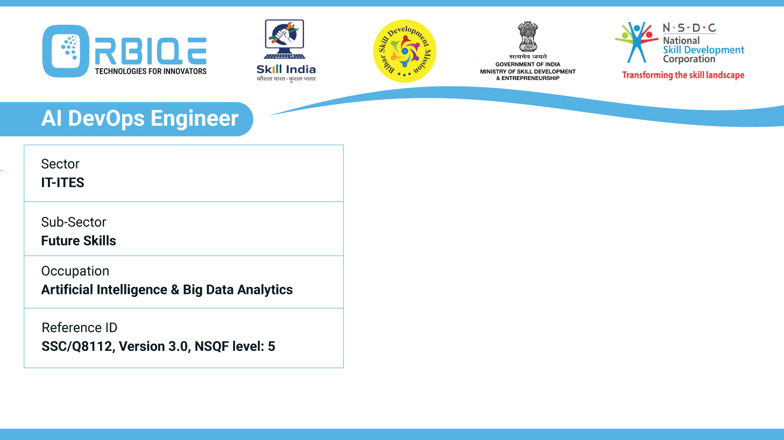
Name- Krishna Kant Dubey

Slide 2

Features of Different Configuration Management Tools

Slide 3
Agenda
Offers declarative language for configuration, centralized management with master-agent architecture, and extensive module library
Provides infrastructure as code, flexible DSL for defining configurations, and support for both push and pull models
Agentless architecture, simple YAML syntax, and easy to learn and use for configuration management and automation

Slide 4
Offers declarative language for configuration, centralized management with master-agent architecture, and extensive module library

Slide 5
Provides infrastructure as code, flexible DSL for defining configurations, and support for both push and pull models

Slide 6
Agentless architecture, simple YAML syntax, and easy to learn and use for configuration management and automation

Slide 7
Thank You

